Slide 1


KV
Karanvir Singh
16-05-2025

Slide 2

Outline
Executive Summary
Introduction
Methodology
Results
Conclusion
Appendix

Slide 3
Executive Summary
Summary of methodologies
SpaceX launch data gathered specifically from SpaceX REST API.
Wrangling data using an API, Sampling Data, and Dealing with Nulls.
Summary of all results
Launch success rate since 2013 kept increasing till 2020.
With heavy payloads the successful landing or positive landing rate are more for Polar, LEO and ISS orbit.
Total Success launches by site is for KSC LC-39A

Slide 4
Introduction
To predict if the Falcon 9 first stage will land successfully
To determine if SpaceX will reuse the first stage
Training a Machine Learning model and use public information to predict if SpaceX will reuse the first stage

Slide 5

Section 1

Slide 6
Methodology
Executive Summary
Data collection methodology:
Making a get request to the SpaceX API
Perform data wrangling
Dealing with Missing Values and focusing on only Falcon 9 launches
Perform exploratory data analysis (EDA) using visualization and SQL
Perform interactive visual analytics using Folium and Plotly Dash
Perform predictive analysis using classification models
Creating a column for the class and Standardizing the data
Splitting into training data and test data
Finding best Hyperparameter for SVM, Classification Trees and Logistic Regression

Slide 7
Data Collection
SpaceX launch data gathered specifically from SpaceX REST API
Targeting a specific endpoint of the API to get past launch data
Another method used to obtain Falcon 9 launch data is using Web scraping
By using the Python BeautifulSoup package to web scrape some HTML tables that contain valuable Falcon 9 launch records
Parsing the data from those tables and convert them into a Pandas data frame for further visualization and analysis

Slide 8
Data Collection – SpaceX API
SpaceX launch data is gathered from an API, specifically the SpaceX REST API.
We worked with the endpoint api.spacexdata.com/v4/launches/past
Using this URL to target a specific endpoint of the API to get past launch data.
Performing a get request using the requests library to obtain the launch data, which we will use to get the data from the API.
https://github.com/Karanvir399/SpaceX-Falcon-9-First-Stage-Landing-Prediction/blob/main/jupyter-labs-spacex-data-collection-api.ipynb

Slide 9
Data Collection - Scraping
Obtaining Falcon 9 Launch data using web scraping related Wiki pages
Using the Python BeautifulSoup package to web scrape some HTML tables that contain valuable Falcon 9 launch records.
Parsing the data from those tables and converting them into a Pandas data frame for further visualization and analysis.
https://github.com/Karanvir399/SpaceX-Falcon-9-First-Stage-Landing-Prediction/blob/main/jupyter-labs-webscraping.ipynb

Slide 10
Data Wrangling
Wrangling Data using an API, Sampling Data, and Dealing with Nulls to transform this raw data into a clean dataset which provides meaningful data
Data to be stored in lists and to be used to create the dataset.
Filtering/Sampling the data to remove Falcon 1 launches as we only need to analyze Falcon 9 launches.
Dealing with null values in order to make the dataset viable for analysis
https://github.com/Karanvir399/SpaceX-Falcon-9-First-Stage-Landing-Prediction/blob/main/labs-jupyter-spacex-Data%20wrangling.ipynb

Slide 11
EDA with Data Visualization
Categorical plots: To visualize relationships, distributions, and comparisons across different categories.
Scatter plot: To visualize the relationship between two numerical (continuous) variables.
Bar Chart: To compare quantities or values across different categories.
Line Chart: To show trends or changes over time (or another continuous variable).
https://github.com/Karanvir399/SpaceX-Falcon-9-First-Stage-Landing-Prediction/blob/main/edadataviz.ipynb

Slide 12
EDA with SQL
Listing unique launch sites
Calculating total payload mass for NASA (CRS) missions
Finding the earliest successful landing date
Retrieving booster versions with successful drone ship landings carrying moderate payloads
Categorizing mission outcomes and counting them
Identifying booster and payload for the heaviest payload
Counting landing outcomes over a time range
https://github.com/Karanvir399/SpaceX-Falcon-9-First-Stage-Landing-Prediction/blob/main/jupyter-labs-eda-sql-coursera_sqllite.ipynb

Slide 13
Build an Interactive Map with Folium
Folium.Circle is used to add a highlighted circle area with a text label on a specific coordinate.
Marker clusters are a good way to simplify a map containing many markers having the same coordinate.
Lines is a standard way to visualize routes, paths, or connections between geographic coordinates.
https://github.com/Karanvir399/SpaceX-Falcon-9-First-Stage-Landing-Prediction/blob/main/lab_jupyter_launch_site_location.ipynb

Slide 14
Build a Dashboard with Plotly Dash
Added a Launch Site Drop-down Input Component
Pie Chart to show total success launches by site
Scatter plot showing correlation between payload and success for different sites
Payload range slider to select the desired payloads
https://github.com/Karanvir399/SpaceX-Falcon-9-First-Stage-Landing-Prediction/blob/main/spacex-dash-app_code.py

Slide 15
Predictive Analysis (Classification)
Preprocessing to standardize our data
Train_test_split, allowing us to split our data into training and testing data
Training the model and performing Grid Search, allowing us to find the hyperparameters that allow a given algorithm to perform best
Using the best hyperparameter values, determining the model with the best accuracy using the training data
https://github.com/Karanvir399/SpaceX-Falcon-9-First-Stage-Landing-Prediction/blob/main/SpaceX_Machine%20Learning%20Prediction_Part_5.ipynb

Slide 16
Results
Exploratory data analysis results:
For the VAFB-SLC launch site there are no rockets launched for heavy payload mass(greater than 10000).
Orbit type ES-L1, GEO, HEO, and SSO have the highest success rates.
With heavy payloads the successful landing or positive landing rate are more for Polar,LEO and ISS.
Launch sucess rate since 2013 kept increasing till 2020

Slide 17
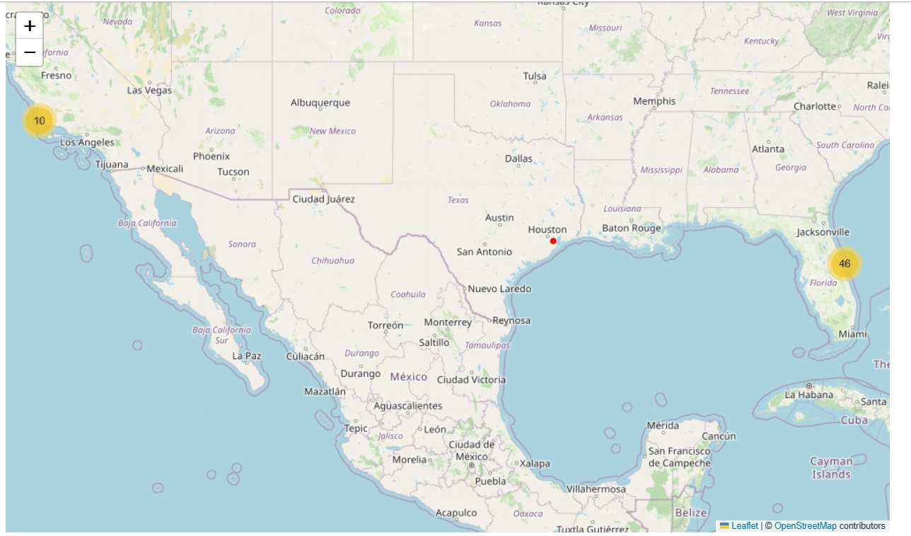
Results
Interactive analytics demo in screenshots

Slide 18
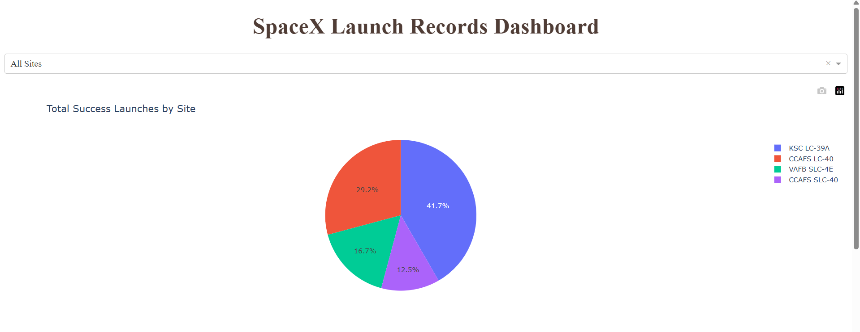
Results
Interactive analytics demo in screenshots

Slide 19
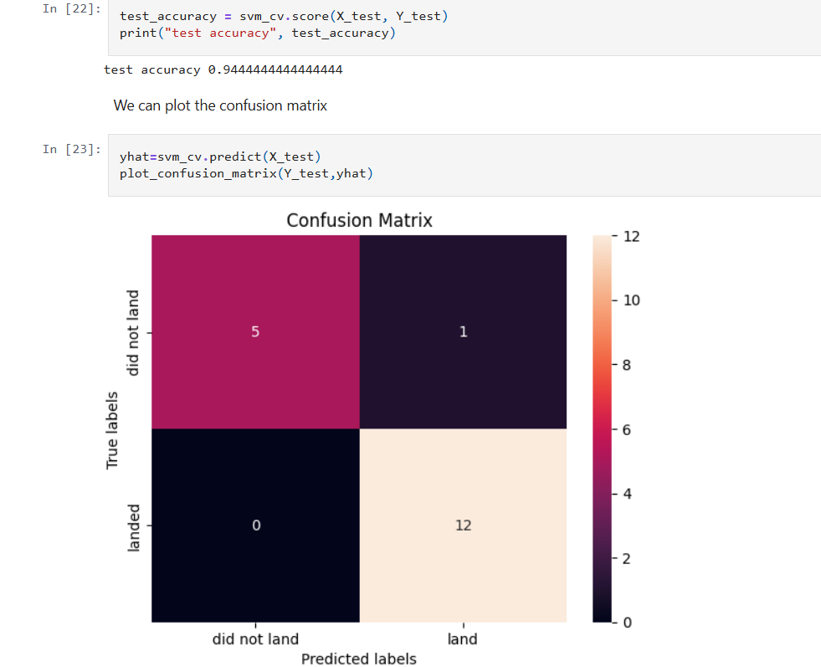
Results
Predictive analysis results

Slide 20

Section 2

Slide 21
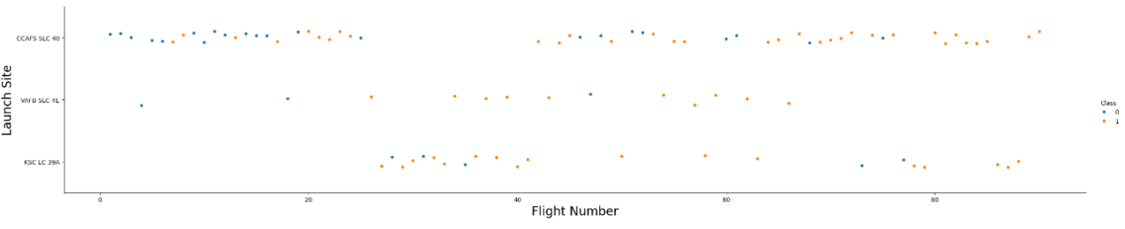
Flight Number vs. Launch Site
This Categorical plot shows that VAFB SLC 4E and KSC LC 39A have a fairly good success rate.
KSC LC 39A and CCAFS SLC 40 site have been used for recent launches.

Slide 22
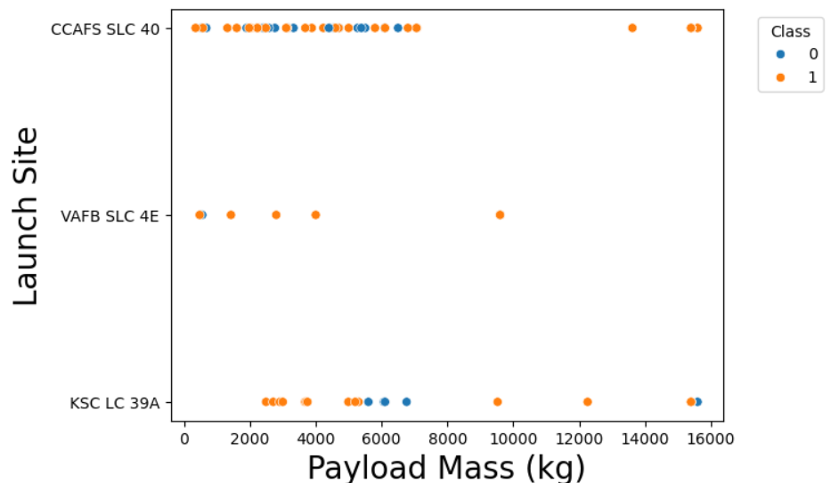
Payload vs. Launch Site
This scatter plot shows that rocket launches with a payload above 8000 kg have a very good rate of success, i.e., 87.5%

Slide 23
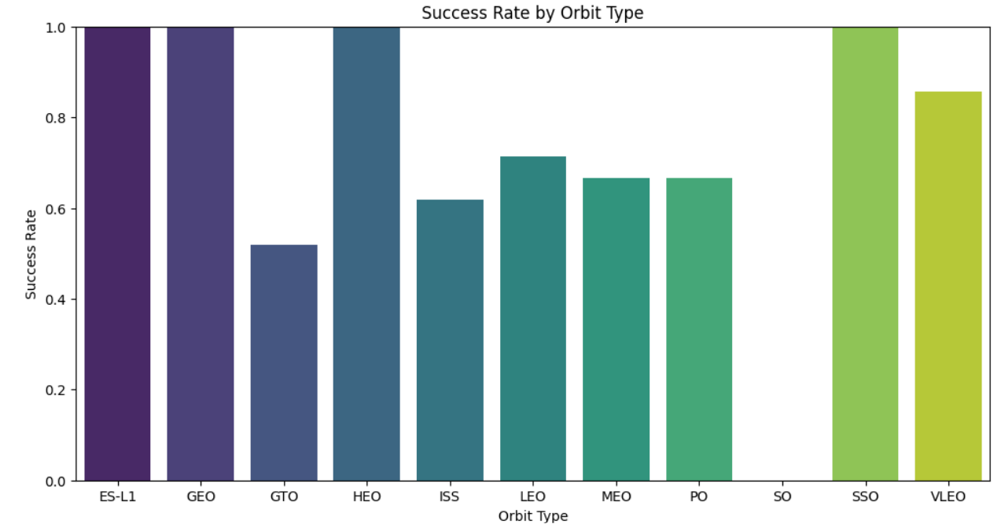
Success Rate vs. Orbit Type
By taking number of launches in account, launches to orbit VLEO have been quite successful and most have been recent launches.
Launches to orbit SSO have been 100% success but the sample size is small.

Slide 24
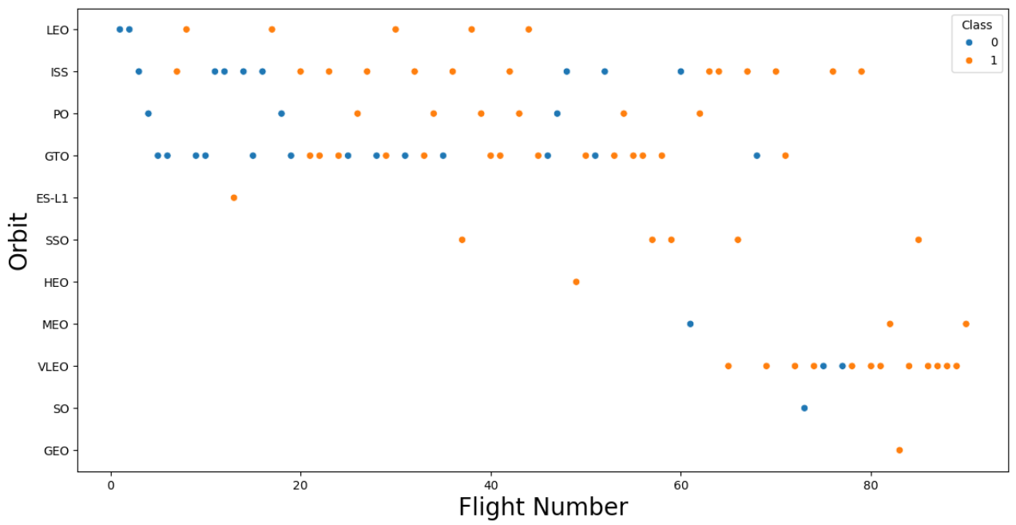
Flight Number vs. Orbit Type
Out of last 30 odd launches, most of the launches were made to Orbit ISS and VLEO
Consistent launches were made to Orbit ISS and GTO in the past

Slide 25
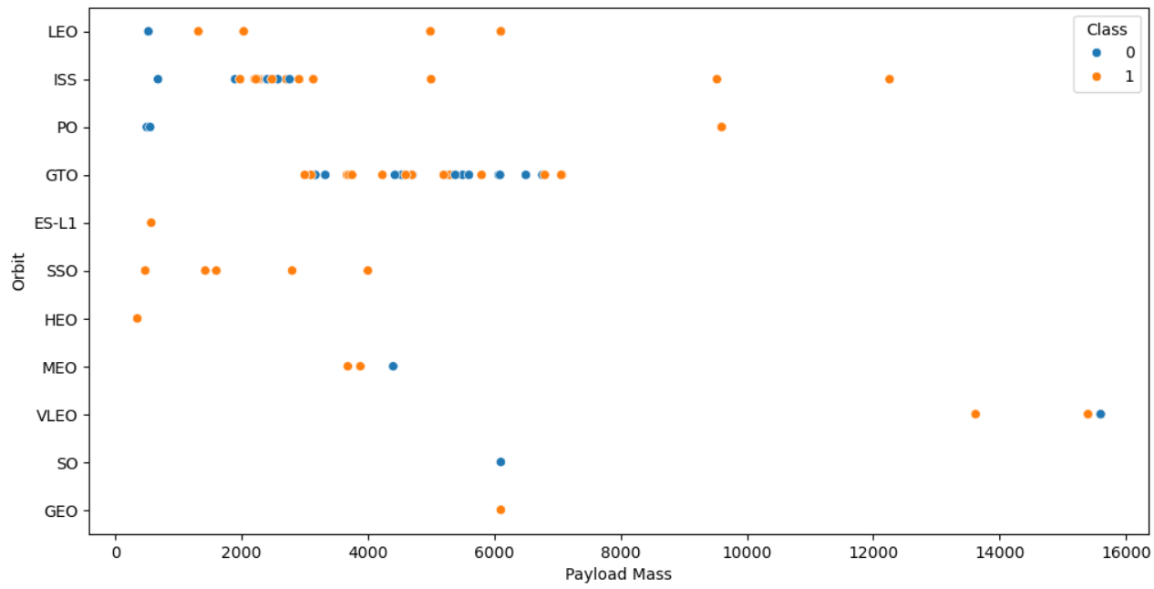
Payload vs. Orbit Type
Payload above 8000 kg have only been sent to orbit ISS, PO, and VLEO
Although sample size is not big, but still, we can make an inference that success rate is around 83% when payload is above 8000 kg.

Slide 26
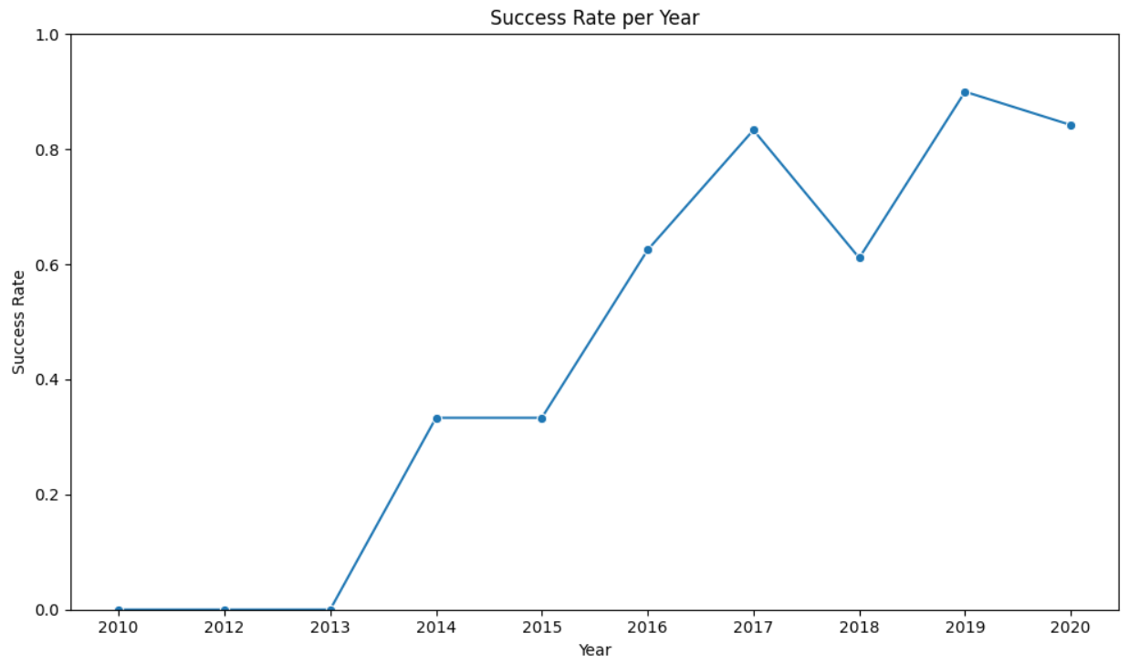
Launch Success Yearly Trend
Launch success rate since 2013 kept increasing till 2020.

Slide 27
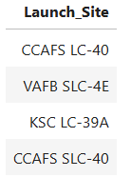
All Launch Site Names
CCAFS LC-40
VAFB SLC-4E
KSC LC-39A
CCAFS SLC-40

Slide 28
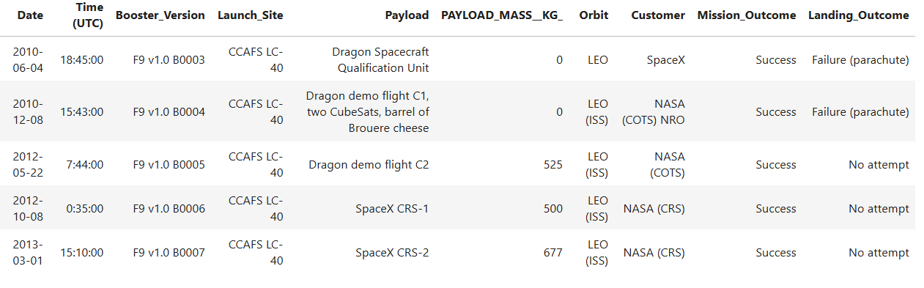
Launch Site Names Begin with 'CCA'

Slide 29
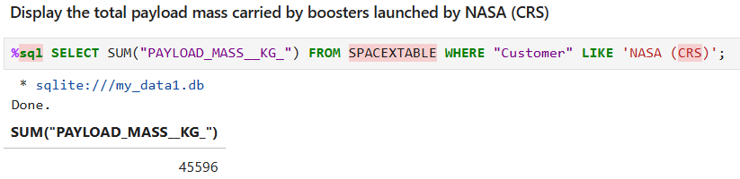
Total Payload Mass

Slide 30
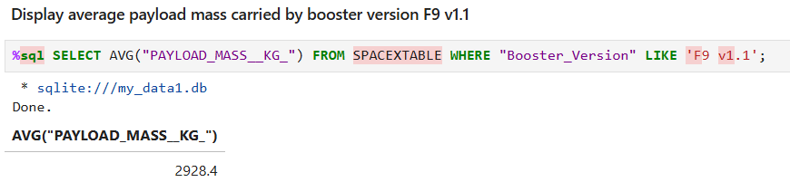
Average Payload Mass by F9 v1.1

Slide 31
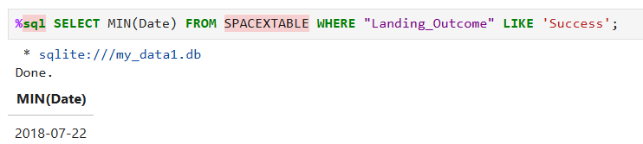
First Successful Ground Landing Date

Slide 32
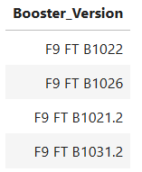
Successful Drone Ship Landing with Payload between 4000 and 6000

Slide 33
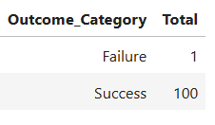
Total Number of Successful and Failure Mission Outcomes
%sql SELECT CASE WHEN "Mission_Outcome" LIKE 'Success%' THEN 'Success' WHEN "Mission_Outcome" LIKE 'Failure%' THEN 'Failure' ELSE 'OTHER' END AS Outcome_Category, COUNT(*) AS Total FROM SPACEXTABLE GROUP BY Outcome_Category;

Slide 34
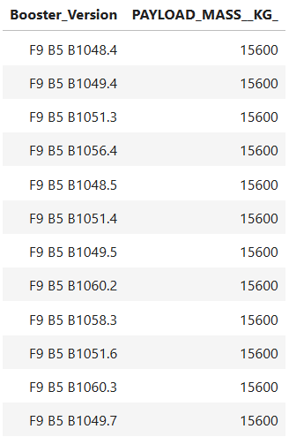
Boosters Carried Maximum Payload

Slide 35
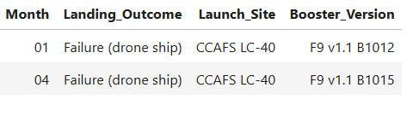
2015 Launch Records
List the failed landing_outcomes in drone ship, their booster versions, and launch site names for in year 2015

Slide 36
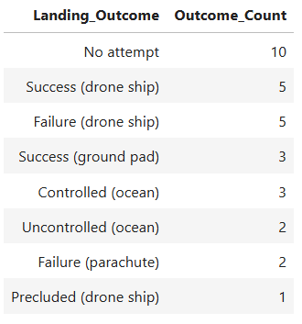
Rank Landing Outcomes Between 2010-06-04 and 2017-03-20
Ranking the count of landing outcomes (such as Failure (drone ship) or Success (ground pad)) between the date 2010-06-04 and 2017-03-20, in descending order

Slide 37

Section 3

Slide 38
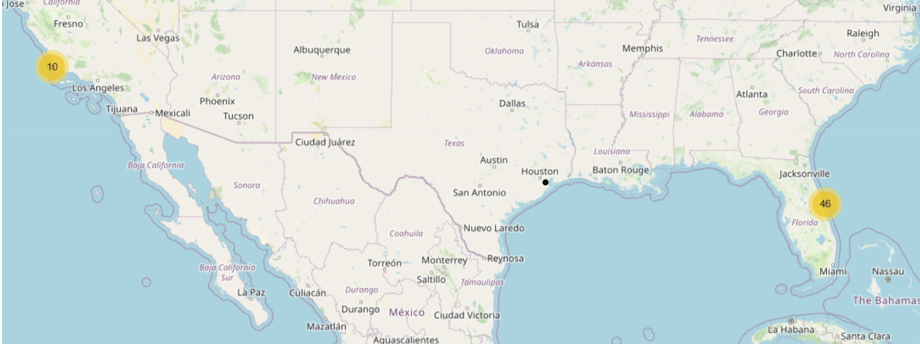
Location markers on a global map
Yellow circles represent Marker clusters simplifying a map containing many markers having the same coordinate.

Slide 39
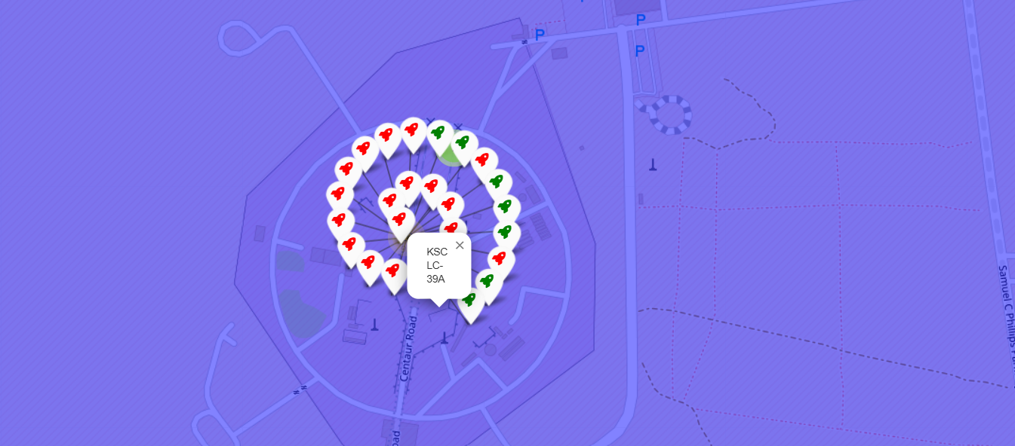
Color-labeled launch outcomes on the map
Red color represents unsuccessful and Green color represents successful launch

Slide 40
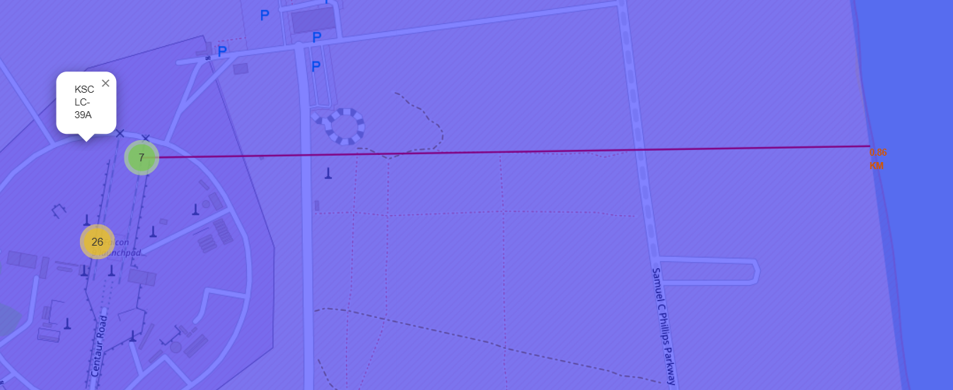
Distance between coastline point and launch site
Purple color line represents distance between the closest coastline point and the launch site

Slide 41

Section 4

Slide 42
Launch success count for all sites
Nearly half of the successful launches have been made from KSC LC-39A

Slide 43
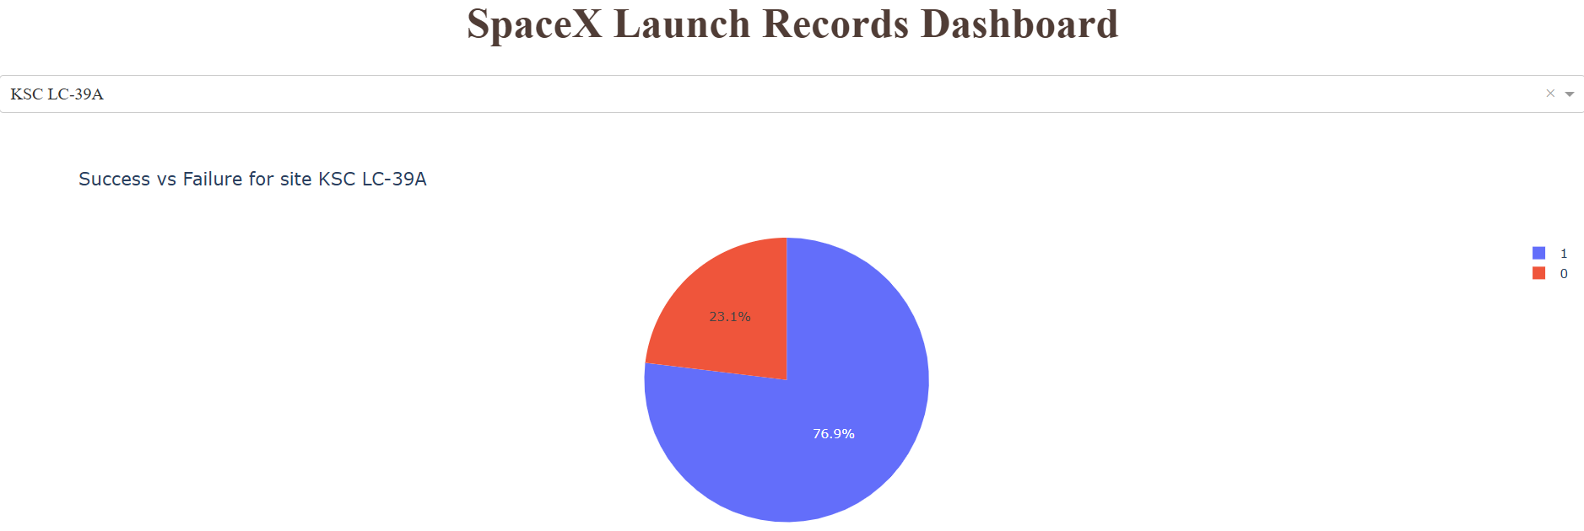
Launch site with highest launch success ratio
10 successful and 3 unsuccessful launches have been made from KSC LC-39A

Slide 44
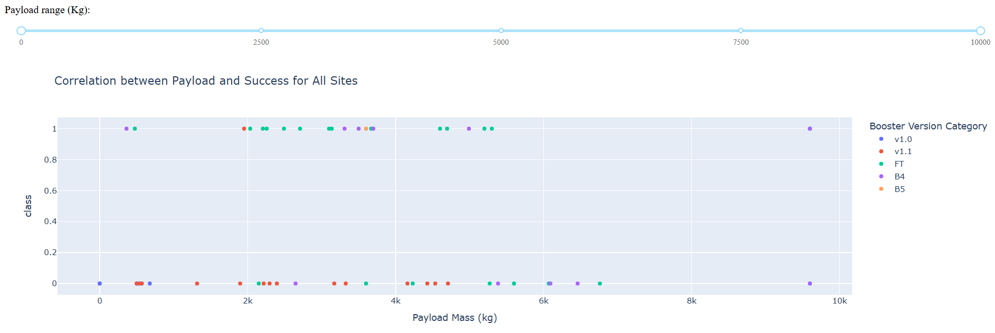
Correlation between Payload and Success for All Sites
In terms of number of launches, most of the successful launches have come when carried payload was between 2k and 4k

Slide 45

Section 5

Slide 46
Classification Accuracy
Model accuracy for all built classification models
SVM model has the highest classification accuracy

Slide 47
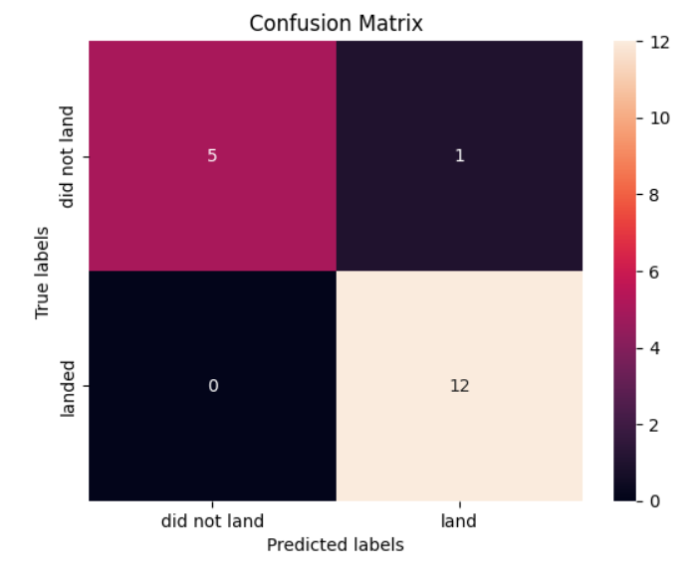
Confusion Matrix
Confusion matrix of the best performing model which is Support Vector Machine model in this case.
It has a test accuracy of 94.44%
True Positive - 12 (True label is landed, Predicted label is also landed)
False Positive - 1 (True label is not landed, Predicted label is landed)

Slide 48
Conclusions
KSC LC 39A and CCAFS SLC 40 site have been used for recent launches.
Past record has shown that Rocket launches with a payload above 8000 kg have a very good rate of success, i.e., 87.5%
By taking number of launches in account, launches to orbit VLEO have been quite successful and most of them have been recent launches.
Out of last 30 odd launches, most of the launches were made to Orbit ISS and VLEO
Nearly half of the successful launches have been made from KSC LC-39A site

Slide 49
Appendix
SpaceX Dash App Code:
https://github.com/Karanvir399/SpaceX-Falcon-9-First-Stage-Landing-Prediction/blob/main/spacex-dash-app_code.py

Slide 50


